Slide 1
DR SNSRCAS, CBE Human Centered Design Thinking Fundamentals 21PCA204 I MCA ODD SEM UNIT II Heuristic Evaluations

Slide 2
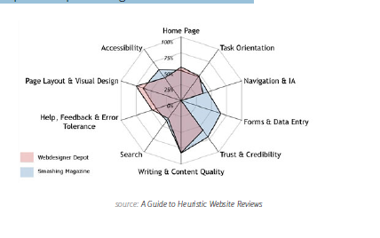
Heuristic Evaluations
Once you have a working prototype, a heuristic evaluation (or usability review)
can be a low-cost method of checking your early iterations against usability best
practices. Heuristic evaluations are also helpful for competitive benchmarking since
you can compare competitors against the same criteria.

Slide 3
Heuristic Evaluations
According to Neil Turner, founder of UX For The Masses, heuristic reviews can
be carried out by non-UX folks provided they follow a set of guidelines. While
they’re cheap and usually only require a day or two, they don’t actually tell you the
usability of a system (since you’re not testing with real users) and may suffer from
inconsistency and subjectivity (since they’re carried out by different people). That
being said, they are a still a great reality check since you’ll be able to catch glaring
UX violations. We’ve summarized a scenario-based approach:

Slide 4
Heuristic Evaluations
Define your usability review scenarios — Define common and important
user tasks. Who uses the product, and is this the first time? What task are they
trying to complete, and what is their goal? For example, when evaluating a
laptop, you would look at scenarios like sending email and watching movies.
• Walk through each scenario — Now that each scenario is defined, you need
to walk through the steps to achieving user goals. Can they see how to do it?
And how will they know if their action was correct? Walk through each scenario
until you think the user achieved their goal or gave up.
Complete a heuristic review scorecard — Use a template such as this
45-point checklist. It’s best to have 3-5 people do this. Remember that a high
score doesn’t mean your product is actually usable, only that it should be
usable.
Oracle uses a streamlined 10-point list of heuristics gauging everything from
application complexity to frequency and helpfulness of error messages. Usability
issues are categorized as either ”low”, ”medium”, or ”high” severity with supporting
notes. The team then isolates the top 10 most important issues for immediate fixing.
If you’re curious about what a full heuristic report may look like, check out this full
heuristic evaluation of Apple iTunes.

Slide 5
Heuristic Evaluations
Define your usability review scenarios — Define common and important
user tasks. Who uses the product, and is this the first time? What task are they
trying to complete, and what is their goal? For example, when evaluating a
laptop, you would look at scenarios like sending email and watching movies.
• Walk through each scenario — Now that each scenario is defined, you need
to walk through the steps to achieving user goals. Can they see how to do it?
And how will they know if their action was correct? Walk through each scenario
until you think the user achieved their goal or gave up.
Complete a heuristic review scorecard — Use a template such as this
45-point checklist. It’s best to have 3-5 people do this. Remember that a high
score doesn’t mean your product is actually usable, only that it should be
usable.
Oracle uses a streamlined 10-point list of heuristics gauging everything from
application complexity to frequency and helpfulness of error messages. Usability
issues are categorized as either ”low”, ”medium”, or ”high” severity with supporting
notes. The team then isolates the top 10 most important issues for immediate fixing.
If you’re curious about what a full heuristic report may look like, check out this full
heuristic evaluation of Apple iTunes.

Slide 6
THANK YOU

